Slide 1
Lending Club Case Study
Dillan Muthanna

Slide 2
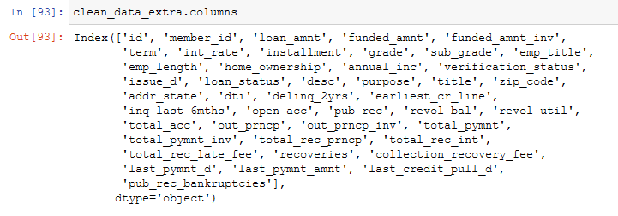
Cleaning columns
About 60 columns out of 111 were full of null values.
A few had redundant columns and had to be removed (eg initial_list_status, application_type, policy_code etc )

Slide 3
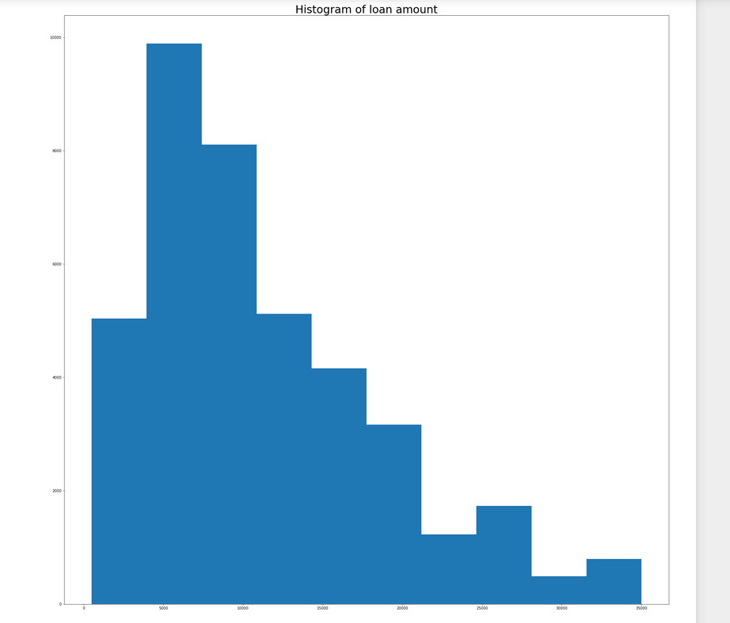
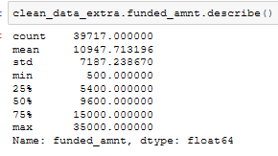
Lets Understand the distribution of loan amount

Slide 4
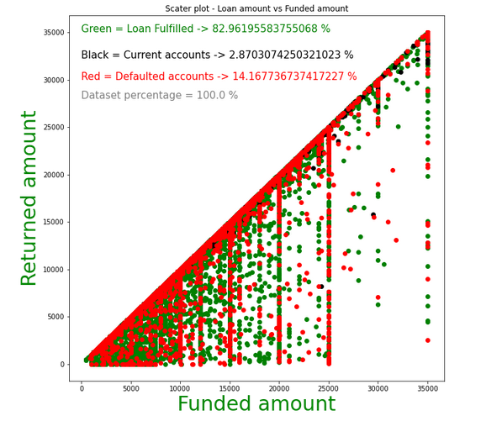
Understanding trend trend in users

Slide 5
Insights
Dataset is valid , there is no single instance where returned amount is greater than funded amount
Funds are generally given around 500 range starting from 0 to 3500

